Slide 1
Quantum Gates and Circuits
NPTEL Course on Quantum Computing: Week 1: Module 4
Lecturer: V. Ramakrishna
Senior Researcher and Quantum Ambassador
IBM Research—India
Notes:
Welcome back to the NPTEL lecture on QC basics.
Thus far you have learned all about quantum states, both mathematically and drawing on ideas from quantum mechanics.
In the last module of this week’s lecture series, you will learn to perform operations on quantum states.

Slide 2
Outline
Building blocks: single qubit gates
Quantum circuits with single qubit gates
Multipartite states
Multiple qubit gates and circuits

Slide 3
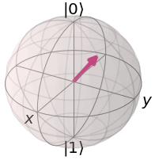
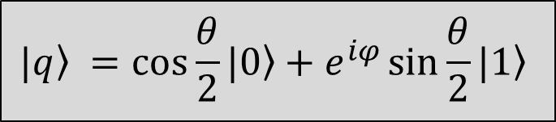
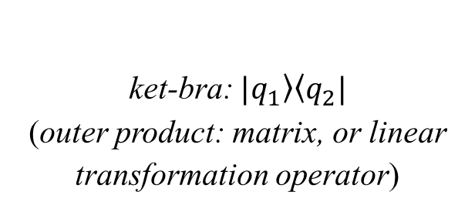
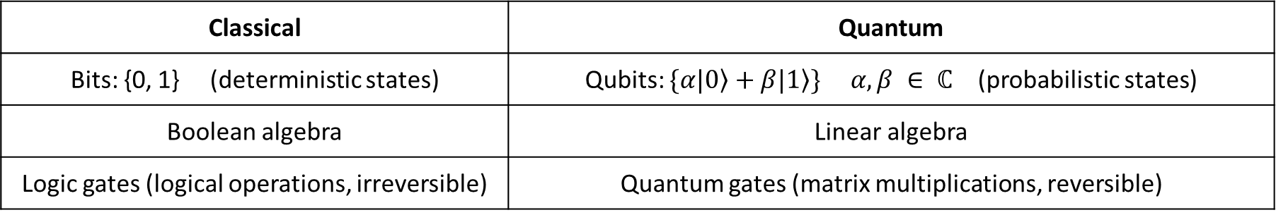

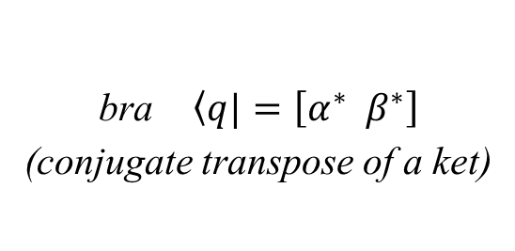
Recap: Quantum Computing and Qubits
Classical | Quantum
Bits: {0, 1} (deterministic states) | Qubits: $\{α\left.|0\right\rangle +β\left.|1\right\rangle \} α,β ∈ ℂ$ (probabilistic states)
Boolean algebra | Linear algebra
Logic gates (logical operations, irreversible) | Quantum gates (matrix multiplications, reversible)
Single qubit: $\left.|q\right\rangle = α\left.|0\right\rangle +β\left.|1\right\rangle =\left[\begin{aligned}α \\ β\end{aligned}\right] α,β ∈ ℂ$
Bloch Sphere
bra $\left\langle q|\right.=\left[α^{∗}{ β}^{∗}\right]$
(conjugate transpose of a ket)
ket (vector)
probability amplitudes
standard basis states
bra-ket: $\left\langle q_{1} | q_{2}\right\rangle$ (inner product: scalar)
ket-bra: $\left.|q_{1}\right\rangle \left\langle q_{2}|\right.$
(outer product: matrix, or linear transformation operator)
$$θ$$
$$\left.|q\right\rangle$$
Measurement
$$P\left(\left.|q\right\rangle =\left.|0\right\rangle \right)=|\left\langle 0 | q\right\rangle |2=|α|2$$
$$P\left(\left.|q\right\rangle =\left.|1\right\rangle \right)=|\left\langle 1 | q\right\rangle |2={\left|β\right|}^{2}$$
$|α|2$ $+ \left|β\right|2=1$
$$φ$$
$$\left.|q\right\rangle =\cos{\frac{θ}{2}}\left.|0\right\rangle +e^{iφ}\sin{\frac{θ}{2}}\left.|1\right\rangle$$
Notes:
Add outer product mention. - DONE

Slide 4
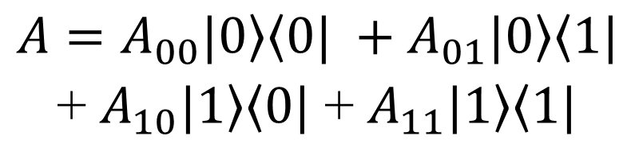

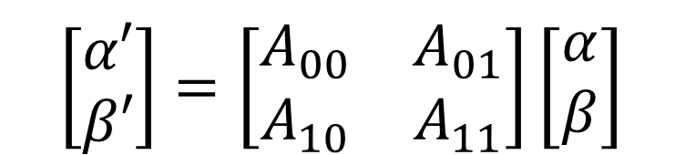

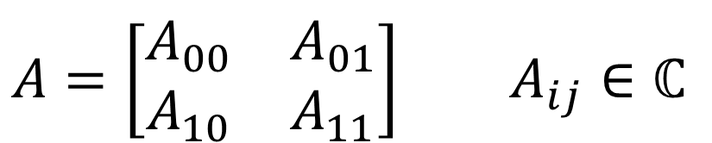
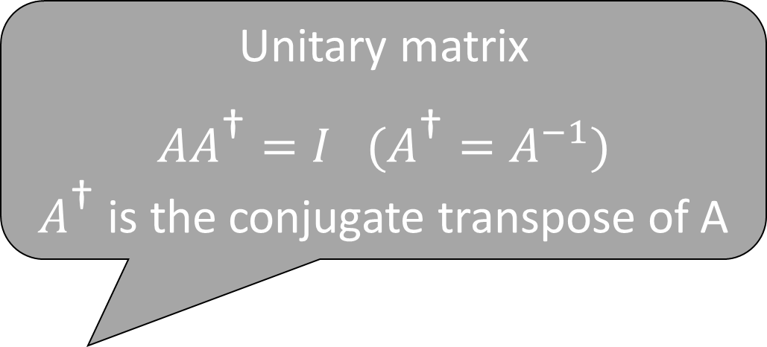

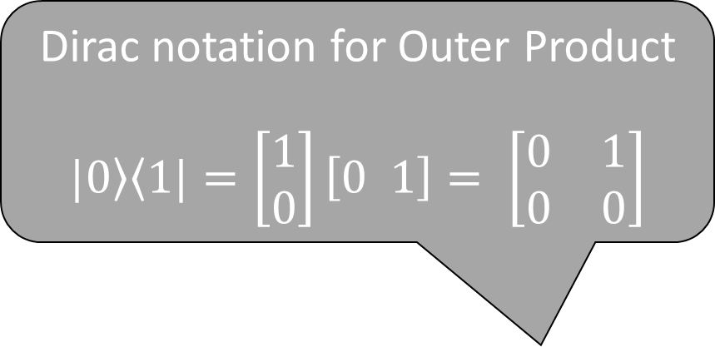
Single Qubit Gates
Elementary computation: changes qubit state
Unitary matrix
$AA^{\text{†}}=I$ $(A^{\text{†}}=A^{−1})$
$A^{\text{†}}$ is the conjugate transpose of A
A
Dirac notation for Outer Product
$$\left.|0\right\rangle \left\langle 1|\right.=\left[\begin{aligned}1 \\ 0\end{aligned}\right]\left[0 1\right]= \left[\begin{matrix}0 & 1 \\ 0 & 0\end{matrix}\right]$$
$$\left.|q\right\rangle$$
$$\left.|q′\right\rangle$$
In mathematical terms: a linear transformation of a vector (ket), or a matrix multiplication
$$A=\left[\begin{matrix}A_{00} & A_{01} \\ A_{10} & A_{11}\end{matrix}\right] A_{ij}∈ℂ$$
$A=A_{00}\left.|0\right\rangle \left\langle 0|\right. +A_{01}\left.|0\right\rangle \left\langle 1|\right.$ + $A_{10}\left.|1\right\rangle \left\langle 0|\right.$ + $A_{11}\left.|1\right\rangle \left\langle 1|\right.$
$$\left[\begin{aligned}α′ \\ β′\end{aligned}\right]=\left[\begin{matrix}A_{00} & A_{01} \\ A_{10} & A_{11}\end{matrix}\right]\left[\begin{aligned}α \\ β\end{aligned}\right]$$
$$\left.|q′\right\rangle = A\left.|q\right\rangle$$
Notes:
Talk about unitary matrix here.
Emphasize outer product representation (can get each element using outer product) - THERE
Expand on one of the outer products above (in the Dirac representation). – DONE
A is a linear combination of the outer products of basis vectors.
Quantum theory is unitary
Therefore, matrices representing gates are also unitary

Slide 5
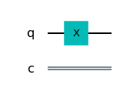
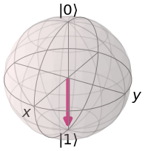
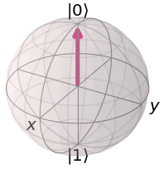


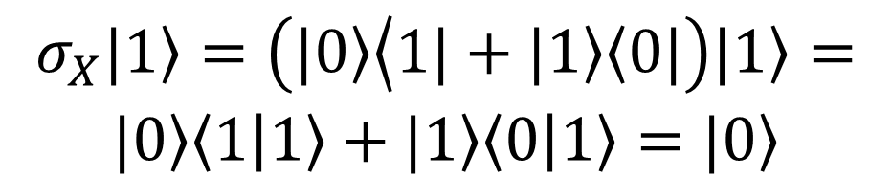

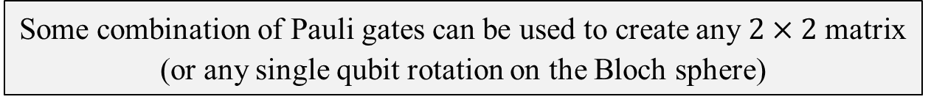
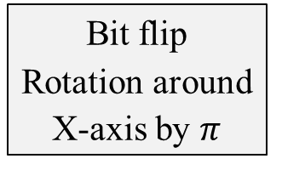
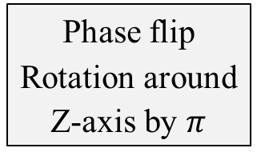
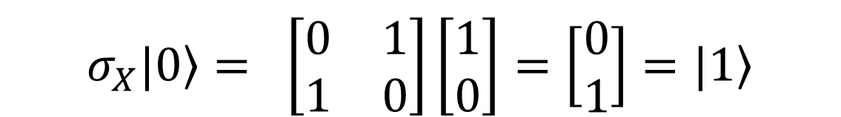
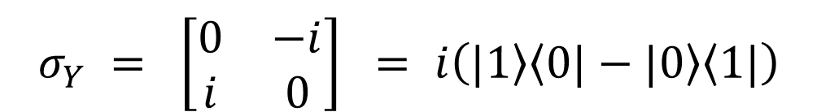
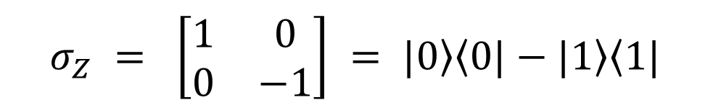
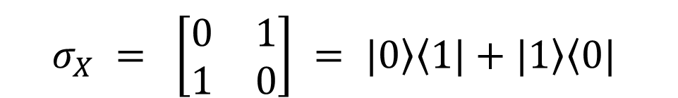
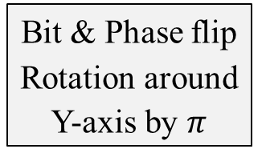
Examples of Single Qubit Gates
Pauli-X,Y,Z Gates
$$σ_{X} = \left[\begin{matrix}0 & 1 \\ 1 & 0\end{matrix}\right] = \left.|0\right\rangle \left\langle 1|\right.+\left.|1\right\rangle \left\langle 0|\right.$$
Bit flip
Rotation around X-axis by $π$
Pauli-X gate
$σ_{X}\left.|0\right\rangle = \left[\begin{matrix}0 & 1 \\ 1 & 0\end{matrix}\right]\left[\begin{aligned}1 \\ 0\end{aligned}\right]=\left[\begin{aligned}0 \\ 1\end{aligned}\right]=\left.|1\right\rangle$
Phase flip
Rotation around Z-axis by $π$
$$σ_{Z} = \left[\begin{matrix}1 & 0 \\ 0 & −1\end{matrix}\right] = \left.|0\right\rangle \left\langle 0|\right.−\left.|1\right\rangle \left\langle 1|\right.$$
Pauli-Z gate
$$σ_{X}\left.|1\right\rangle =\left(\left.|0\right\rangle \left\langle 1|+\left.|1\right\rangle \left\langle 0|\right.\right.\right)\left.|1\right\rangle =$$
$\left.|0\right\rangle \left\langle 1 | 1\right\rangle +\left.|1\right\rangle \left\langle 0 | 1\right\rangle =\left.|0\right\rangle$
$$σ_{Y} = \left[\begin{matrix}0 & −i \\ i & 0\end{matrix}\right] = i\left(\left.|1\right\rangle \left\langle 0|\right.−\left.|0\right\rangle \left\langle 1|\right.\right)$$
$$σ_{Z}\left.|+\right\rangle =\left.|−\right\rangle σ_{Z}\left.|−\right\rangle =\left.|+\right\rangle$$
Pauli-Y gate
$$= iσ_{X}σ_{Z}$$
Bit & Phase flip
Rotation around Y-axis by $π$
$$∀i ∈\left\{X,Y,Z\right\} σ_{i}^{2}=I$$
$$σ_{X}(α\left.|0\right\rangle + β\left.|1\right\rangle )=β\left.|0\right\rangle +α\left.|1\right\rangle$$
Some combination of Pauli gates can be used to create any $2×2$matrix (or any single qubit rotation on the Bloch sphere)
Notes:
Transformations on Bloch sphere representing gate operations, Also show the matrix multiplication equivalents.
Pauli-X,Y,Z gates. Hadamard gate, S-gate.
Mention: NOT (X) gate can also act on superposition states.

Slide 6

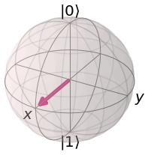
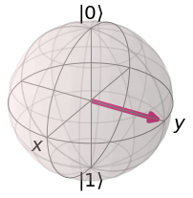
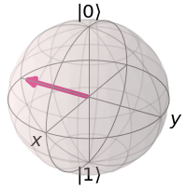
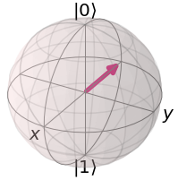

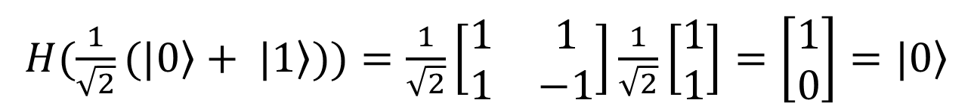
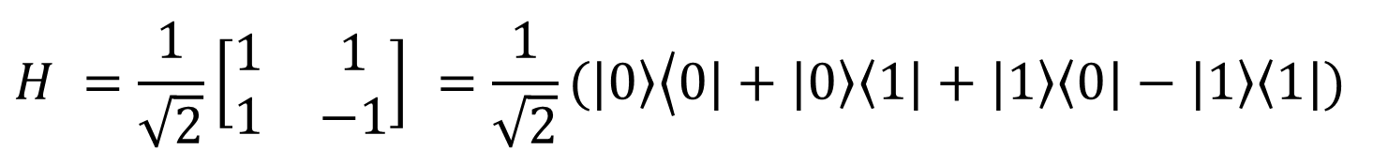
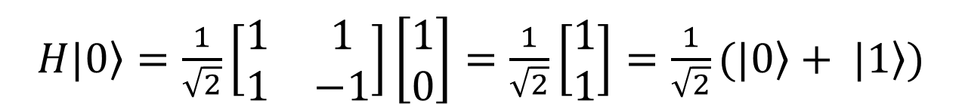
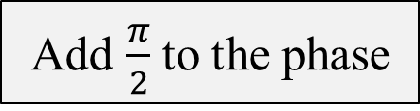


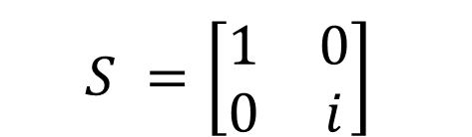
Examples of Single Qubit Gates
Hadamard Gate
$$H =\frac{1}{\sqrt{2}}\left[\begin{matrix}1 & 1 \\ 1 & −1\end{matrix}\right] =\frac{1}{\sqrt{2}}(\left.|0\right\rangle \left\langle 0|+\left.|0\right\rangle \left\langle 1|\right.\right.+\left.|1\right\rangle \left\langle 0|\right.−\left.|1\right\rangle \left\langle 1|\right.)$$
Change between X and Z bases
$H\left.|0\right\rangle =\frac{1}{\sqrt{2}}\left[\begin{matrix}1 & 1 \\ 1 & −1\end{matrix}\right]\left[\begin{aligned}1 \\ 0\end{aligned}\right]=\frac{1}{\sqrt{2}}\left[\begin{aligned}1 \\ 1\end{aligned}\right]=\frac{1}{\sqrt{2}}(\left.|0\right\rangle + \left.|1\right\rangle )$
S Gate
$$S =\left[\begin{matrix}1 & 0 \\ 0 & i\end{matrix}\right]$$
$H(\frac{1}{\sqrt{2}}(\left.|0\right\rangle + \left.|1\right\rangle ))=\frac{1}{\sqrt{2}}\left[\begin{matrix}1 & 1 \\ 1 & −1\end{matrix}\right]\frac{1}{\sqrt{2}}\left[\begin{aligned}1 \\ 1\end{aligned}\right]=\left[\begin{aligned}1 \\ 0\end{aligned}\right]=\left.|0\right\rangle$
$$S\left.|+\right\rangle =\left.|+i\right\rangle$$
$$S\left.|−\right\rangle =\left.|−i\right\rangle$$
Add $\frac{π}{2}$to the phase
Notes:
Mention that this is a recall from Prabha’s lecture. - MENTION
To measure on X-basis: apply H and do a Z-measurement
To measure on Y-basis, apply SH and Z-measurement
Assignment: rotation gates: decomposing standard gates as rotation gates.

Slide 7
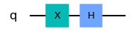
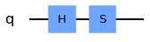
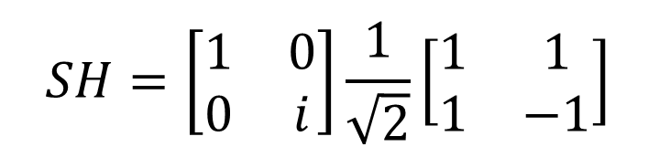




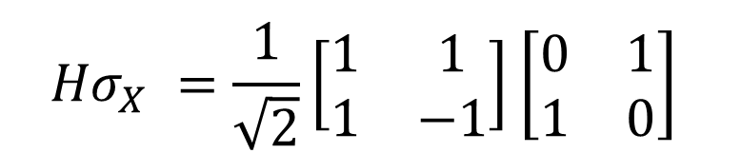

Quantum Circuit
Sequence of building blocks (gates)
Gates carry out elementary computations
Circuits carry out complex computations
$${Hσ}_{X} =\frac{1}{\sqrt{2}}\left[\begin{matrix}1 & 1 \\ 1 & −1\end{matrix}\right]\left[\begin{matrix}0 & 1 \\ 1 & 0\end{matrix}\right]$$
$$= \frac{1}{\sqrt{2}}\left[\begin{matrix}1 & 1 \\ −1 & 1\end{matrix}\right]$$
Matrix multiplication
$${Hσ}_{X}\left.|0\right\rangle =\left.|−\right\rangle$$
$${Hσ}_{X}\left.|1\right\rangle =\left.|+\right\rangle$$
Unitary matrix (combination of linear transformations is a linear transformation)
$$SH=\left[\begin{matrix}1 & 0 \\ 0 & i\end{matrix}\right]\frac{1}{\sqrt{2}}\left[\begin{matrix}1 & 1 \\ 1 & −1\end{matrix}\right]$$
Change between Y and Z bases
$$SH\left.|0\right\rangle =\left.|+i\right\rangle$$
$$S\left.H|1\right\rangle =\left.|−i\right\rangle$$
Notes:
Product of unitary matrices is a unitary matrix; combination of LTs is an LT. - DONE
Pictures: show time flows from left to right. - DONE
Sequence of building blocks (gates) that carry out elementary computations
Show symbols for circuit lines and measurement lines, and different operators
Matrix multiplication order: reverse of gate sequence

Slide 8
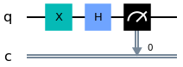
Quantum Circuit
Measurement following input and computation
Computation
$$q^{′}= {Hσ}_{X}q=α′\left.|0\right\rangle + β′\left.|1\right\rangle$$
Input
Measurement (Output)
Time
$$c= \left.|0\right\rangle with probability {\left|α′\right|}^{2}$$
$$c= \left.|1\right\rangle with probability {\left|β′\right|}^{2}$$
Notes:
Sequence of building blocks (gates) that carry out elementary computations
Show symbols for circuit lines and measurement lines, and different operators
Matrix multiplication order: reverse of gate sequence

Slide 9
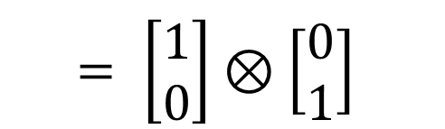
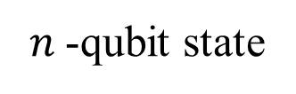
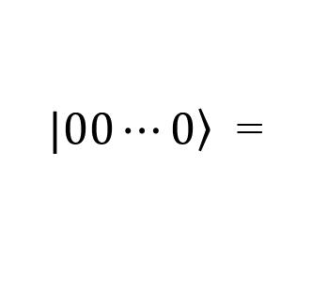




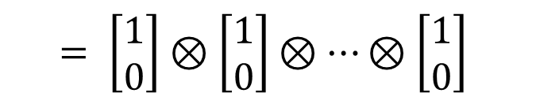

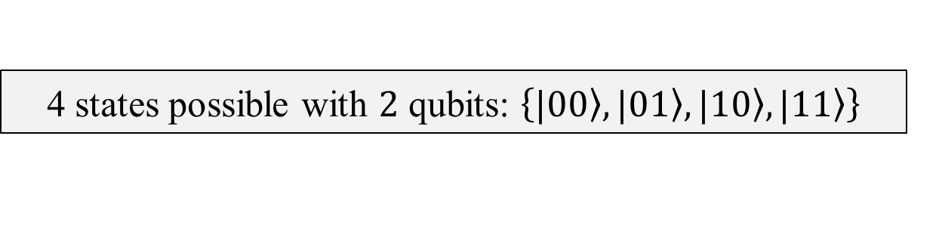
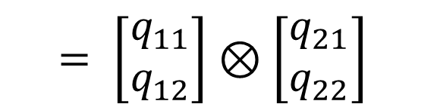
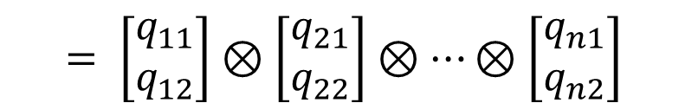
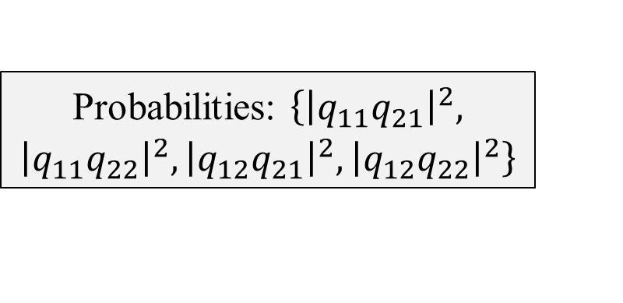
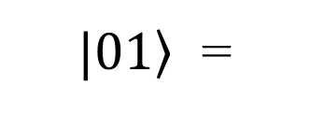




Multiple Qubits and Multipartite Quantum States
Scale up state space by combining single qubits
With $n$ qubits, we can represent $2^{n}$ states (vectors)
Tensor product
$2^{n}$-dim vector (multipartite state)
$$= \left[\begin{aligned}q_{11}q_{21} \\ q_{11}q_{22} \\ q_{12}q_{21} \\ q_{12}q_{22}\end{aligned}\right]$$
$$= \left[\begin{aligned}q_{11} \\ q_{12}\end{aligned}\right]⊗\left[\begin{aligned}q_{21} \\ q_{22}\end{aligned}\right]$$
$$= \left[\begin{aligned}q_{11}q_{21}⋯q_{n1} \\ ⋮ \\ q_{12}q_{22}⋯q_{n2}\end{aligned}\right]$$
4-dim vector
(bipartite state)
2-qubit state
$$\left.|q_{1}\right\rangle ⊗\left.|q_{2}\right\rangle$$
$$= \left[\begin{aligned}q_{11} \\ q_{12}\end{aligned}\right]⊗\left[\begin{aligned}q_{21} \\ q_{22}\end{aligned}\right]⊗⋯⊗\left[\begin{aligned}q_{n1} \\ q_{n2}\end{aligned}\right]$$
$n$-qubit state
$$\left.|q_{1}\right\rangle ⊗\left.|q_{2}\right\rangle ⊗⋯⊗\left.|q_{n}\right\rangle$$
$$= \left[\begin{aligned}0 \\ 1 \\ 0 \\ 0\end{aligned}\right]$$
$$= \left[\begin{aligned}1 \\ 0 \\ ⋮ \\ 0\end{aligned}\right]$$
$$= \left[\begin{aligned}1 \\ 0\end{aligned}\right]⊗\left[\begin{aligned}0 \\ 1\end{aligned}\right]$$
Probabilities: $\left\{{\left|q_{11}q_{21}\right|}^{2}, {\left|q_{11}q_{22}\right|}^{2},{\left|q_{12}q_{21}\right|}^{2},{\left|q_{12}q_{22}\right|}^{2}\right\}$
$\left.|01\right\rangle$ =
$$\left.|0\right\rangle ⊗\left.|1\right\rangle$$
$$= \left[\begin{aligned}1 \\ 0\end{aligned}\right]⊗\left[\begin{aligned}1 \\ 0\end{aligned}\right]⊗⋯⊗\left[\begin{aligned}1 \\ 0\end{aligned}\right]$$
${\left.|0\right\rangle }^{⊗n}$ =
$\left.|00⋯0\right\rangle$ =
$$\left.|0\right\rangle ⊗\left.|0\right\rangle ⊗⋯⊗\left.|0\right\rangle$$
Dirac notation
Dirac notation
$$q_{11}q_{21}\left.|00\right\rangle +q_{11}q_{22}\left.|01\right\rangle +q_{12}q_{21}\left.|10\right\rangle +q_{12}q_{22}\left.|11\right\rangle$$
$$q_{11}⋯q_{n1}{\left.|0\right\rangle }^{⊗n}+ ⋯ +q_{1n}{⋯q}_{nn}{\left.|1\right\rangle }^{⊗n}$$
4 states possible with $2$ qubits: $\left\{\left.|00\right\rangle ,\left.|01\right\rangle ,\left.|10\right\rangle ,\left.|11\right\rangle \right\}$
Notes:
Quantum state on multiple qubits
Representation from 2 to n, tensor product, visual representation in Q-sphere
Dirac notation, vector (matrix) notation
Mention why the output has 2^n states.

Slide 10


State Classification
Product State: state that can be expressed as a tensor product of two states
$\left.|01\right\rangle$ = $\left.|0\right\rangle ⊗\left.|1\right\rangle$
$$\frac{1}{2}\left(\left.|00\right\rangle +\left.|01\right\rangle +\left.|10\right\rangle +\left.|11\right\rangle \right) = \frac{1}{\sqrt{2}}(\left.|0\right\rangle +\left.|1\right\rangle )⊗\frac{1}{\sqrt{2}}(\left.|0\right\rangle +\left.|1\right\rangle )$$
Entangled State: state that cannot be expressed as a tensor product of two states
$$\frac{1}{\sqrt{2}}(\left.|00\right\rangle +\left.|11\right\rangle )$$
Notes:
Product vs entangled states (don’t talk about pure/mixed states). - DONE
Uncorrelated, correlated, entangled states
Allude to pure vs mixed states (can’t be expressed as a ket with a coherent superposition of 0 and 1 because of decoherence; lies within the Bloch sphere)

Slide 11











Visual Representation of Multipartite State
$\frac{1}{2\sqrt{2}}(\left.|000\right\rangle +\left.|001\right\rangle +\left.|010\right\rangle$ $+\left.|100\right\rangle$ $+\left.|101\right\rangle$ $+\left.|011\right\rangle$ $+\left.|110\right\rangle$ $+\left.|111\right\rangle$)
Q-Sphere
$\left.|000\right\rangle$
$\left.|00\right\rangle$
Phase shifted $−\left.|00\right\rangle$
3-qubit states
2-qubit states
North Pole: ${\left.|0\right\rangle }^{⊗n}$
South Pole: ${\left.|1\right\rangle }^{⊗n}$
3-qubit states
$\frac{1}{\sqrt{2}}(\left.|00\right\rangle +\left.|11\right\rangle$)
2-qubit states
Notes:
Mention that this will be covered in the next (Qiskit/Q-Exp) lecture.
Representation as circuits, examples

Slide 12







Multiple Qubit Gates
Transforms multipartite quantum state
A
$$\left.|q_{1}⋯q_{n}\right\rangle$$
$$\left.|q_{1}′⋯q_{n}′\right\rangle$$
Quantum theory is unitary
Matrices representing gates are unitary: $AA^{\text{†}}=I$
A
$$\left.|q_{1}\right\rangle$$
$$⋮$$
$$\left.|q_{n}\right\rangle$$
$$\left.|q_{1}′\right\rangle$$
$$⋮$$
$$\left.|q_{n}′\right\rangle$$
Extra outputs for recovery of inputs: reversibility
Which implies that matrices representing gates are invertible: $A^{\text{†}}=A^{−1}$
Which means that quantum gates (and circuits) must be reversible
Knowing $A$ (function), $\left.|q_{1}\right\rangle ⋯\left.|q_{n}\right\rangle$ can be recovered from $\left.|q_{1}′\right\rangle ⋯\left.|q_{n}′\right\rangle$
Notes:
Representation as circuits, examples
Refer to tensor product of matrices (gates), with parallel Hadamard as example

Slide 13
















The CNOT Gate
Equivalent of the XOR gate in classical computing
Controlled NOT (or Controlled-X)
$$CNOT = \left[\begin{aligned}1 0 0 0 \\ 0 1 0 0 \\ 0 0 0 1 \\ 0 0 1 0\end{aligned}\right]$$
$$\left.|q_{1}q_{2}\right\rangle$$ | Output
$$\left.|00\right\rangle$$ | $$\left.|00\right\rangle$$
$$\left.|01\right\rangle$$ | $$\left.|01\right\rangle$$
$$\left.|10\right\rangle$$ | $$\left.|11\right\rangle$$
$$\left.|11\right\rangle$$ | $$\left.|10\right\rangle$$
Can compute $\left.|q_{2}\right\rangle$from outputs (reversibility)
Can compute $\left.|q_{2}\right\rangle$from outputs (reversibility)
Control qubit
$$\left.|q_{1}\right\rangle$$
$$\left.|q_{1}\right\rangle$$
$$=\left.|00\right\rangle \left\langle 00|\right.+\left.|01\right\rangle \left\langle 01|\right.+\left.|10\right\rangle \left\langle 11|\right.+\left.|11\right\rangle \left\langle 10|\right.$$
$$\left.|q_{2}\right\rangle$$
$$\left.|q_{1}⊕q_{2}\right\rangle$$
$$= \left[\begin{aligned}1 0 0 0 \\ 0 1 0 0 \\ 0 0 0 1 \\ 0 0 1 0\end{aligned}\right]\left[\begin{aligned}1 \\ 0 \\ 0 \\ 0\end{aligned}\right]$$
$$=\left[\begin{aligned}1 \\ 0 \\ 0 \\ 0\end{aligned}\right]$$
$$CNOT\left.|00\right\rangle$$
$$=\left.|00\right\rangle$$
Computes a NOT (Pauli-X) if control qubit is $\left.|1\right\rangle$

Slide 14






Other Multi-Qubit Gates
CNOT is also called CX (Controlled-X or Controlled-Pauli-X)
Similarly, there are 2-qubit gates called CY and CZ, which preserve the state of a qubit if the control qubit is $\left.|0\right\rangle$ and transform it if the control qubit is $\left.|1\right\rangle$
$$Toffoli (CCNOT) = \left[\begin{aligned}1 0 0 0 0 0 0 0 \\ 0 1 0 0 0 0 0 0 \\ 0 0 1 0 0 0 0 0 \\ 0 0 0 1 0 0 0 0 \\ 0 0 0 0 1 0 0 0 \\ 0 0 0 0 0 1 0 0 \\ 0 0 0 0 0 0 0 1 \\ 0 0 0 0 0 0 1 0\end{aligned}\right]$$
$$CPHASE = \left[\begin{aligned}1 0 0 0 \\ 0 1 0 0 \\ 0 0 1 0 \\ 0 0 0 e^{iφ}\end{aligned}\right]$$
$$SWAP = \left[\begin{aligned}1 0 0 0 \\ 0 0 1 0 \\ 0 1 0 0 \\ 0 0 0 1\end{aligned}\right]$$
Shifts phase by $φ$ only if state is $\left.|11\right\rangle$
Swaps two qubits
Flips third qubit (NOT) only if first two (control) are $\left.|1\right\rangle$and $\left.|1\right\rangle$
Notes:
Just mention them without going into details

Slide 15


















Superposition of Multipartite State
Get an equal superposition of an $n$-qubit state to produce a $2^{n}$ state space
$${ H}^{⊗n}\left.|00⋯0\right\rangle$$
$$\left.|q_{1}\right\rangle$$
$$H\left.|q_{1}\right\rangle$$
$$=H^{⊗n}\left[\begin{aligned}1 \\ 0 \\ ⋮ \\ 0\end{aligned}\right]$$
$$= \frac{1}{\sqrt{2^{n}}}\left[\begin{aligned}1 \\ 1 \\ ⋮ \\ 1\end{aligned}\right]$$
$$\left.|q_{2}\right\rangle$$
$$H\left.|q_{2}\right\rangle$$
$$H^{⊗n}\left.|q_{1}q_{2}⋯q_{n}\right\rangle$$
$$⋮$$
$$⋮$$
$$⋮$$
$$\left.|q_{n}\right\rangle$$
$$H\left.|q_{n}\right\rangle$$
$2^{n}$-dim column matrix
$2^{n}$-dim column matrix
$$H^{⊗n}$$
$2^{n}×2^{n}$ matrix (tensor product)
Notes:
Show Hadamard circuit and Hadamard power symbol

Slide 16
Universality
Universal Gate: Single gate or set of gates that can compute any function through some combination
Classical Computing
Quantum Computing
{AND, OR, NOT}
NAND
NOR
{H, T, CNOT}: 2-qubit
{H, Toffoli}
Implement any possible boolean function (i.e., logical expression)
Implement any possible unitary function (i.e., matrix)
Notes:
Related to classical circuits: NAND and NOR are universal gates, forming building blocks for any logic circuit.
Here we have equivalents: H, T, and CNOT gates together form a universal gate set. (or H plus Toffoli)
In QC, we need to be able to implement any possible unitary matrix with such a gate set.

Slide 17











Circuit Identities
Not all important gates can be directly applied by hardware
Instead, we can derive certain gates using a combination of other gates supported by the hardware
E.g., not directly available in IBM-Q
$$CNOT (or CX)$$
E.g., can be directly applied in IBM-Q
$$CZ$$
$$\left.|q_{1}\right\rangle$$
$$\left.|q_{1}\right\rangle$$
$$\left.|q_{1}\right\rangle$$
$$\left.|q_{1}\right\rangle$$
$$\left.|q_{2}\right\rangle$$
$$\left.|q_{1}⊕q_{2}\right\rangle$$
$$\left.|q_{2}\right\rangle$$
$$\left.|q_{2}′\right\rangle$$
Conditional bit flip
Conditional phase flip
Derive an identity to realize CZ gate using the CX gate!
Notes:
We can go from one to the other. - MENTION
(Mention IBM Q; has CX but not CZ). Varies across hardware. Also, for efficiency reasons, some gates are available as basic gates and others not. - MENTION

Slide 18

















Circuit Identities
Use Hadamard gates to switch X,Z bases
$H\left.|0\right\rangle =\left.|+\right\rangle$ $H\left.|1\right\rangle =\left.|−\right\rangle H\left.|+\right\rangle =\left.|0\right\rangle H\left.|−\right\rangle =\left.|1\right\rangle$
Using matrix multiplication, we can derive:
$$HXH=Z$$
$$HZH=X$$
$$CZ$$
Another example
$$SWAP$$
$$\left.|q_{1}\right\rangle$$
$$\left.|q_{1}\right\rangle$$
$$\left.|q_{1}\right\rangle$$
$$\left.|q_{2}\right\rangle$$
$$\left.|q_{2}\right\rangle$$
$$\left.|q_{2}′\right\rangle$$
$$\left.|q_{2}\right\rangle$$
$$\left.|q_{1}\right\rangle$$
$$H − CNOT−H$$
$$CNOT−CNOT−CNOT$$
Notes:
Say, states are decomposed as (not “represented”) - MENTION

Slide 19
Summary and Preview of Next Lesson
Thus far, you have learned about
Qubits, and single and multiple qubit states
Quantum gates and their properties, and seen how to use them as building blocks for quantum circuits (or algorithms)
Next week, you will learn about
The concepts of entanglement and interference before moving on to practical programming

